Slide 1

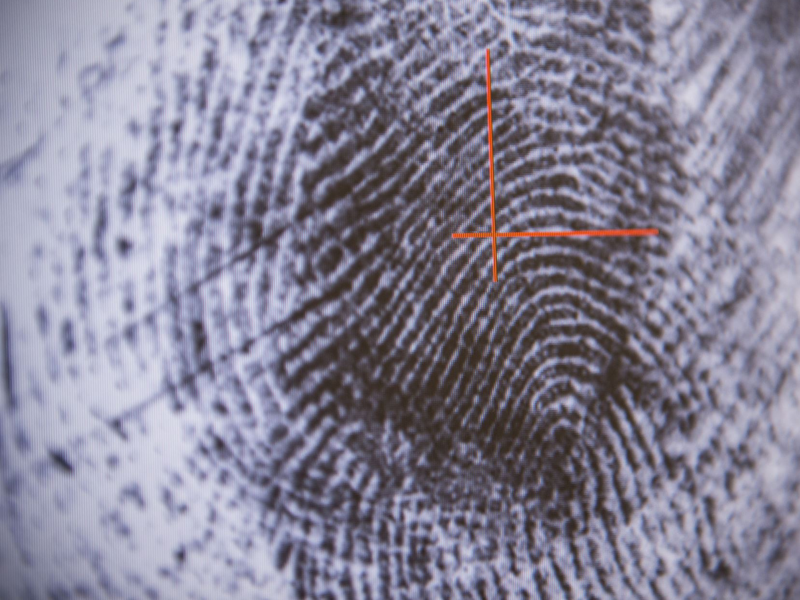
HAND GESTURE DETECTION AND EYE MOTION TRACKER

Slide 2
TEAM MEMBERS AND GUIDE DETAILS
G Satya Swaroop – 2451-19-737-014
M Sai Priyanka – 2451-19-737-016
T Rithika – 2451-19-737-019
Working on this project under the guidance of
Mrs Devaki Kuthadi ,Assistant Professor , ITD.

Slide 3
CONTENTS
Abstract
Existing System
Proposed System
System requirements
Conclusion
Reference
Introduction
Literature Survey
Problem statement
Design phase
Architecture
Methodology
Packages
Results

Slide 4
ABSTRACT
Non-Verbal communication is popular way of transmitting message through expression and body language. Hand gestures and Eye-motion are one of the widely used expressions in Non-verbal communication.
Our project aims to detect Hand Gestures and Track Eye-Motion. By this project we can detect the hand signs which are popularly used in Sign Language and sense the movement of Eyes.

Slide 5
INTRODUCTION
The basic goal of Human Computer Interaction is to improve the interaction between users and computers by making the computer more receptive to user needs. Interaction between humans comes from different sensory modes like gesture, speech, facial and body expressions. Being able to interact with the system naturally is becoming ever more important in many fields of Human Computer Interaction. an individual human computer interface system using eye motion and hand gestures is introduced. Traditionally, human computer interface uses mouse, keyboards an input device.

Slide 6
LITERATURE SURVEY
S.NO | AUTHOR NAME | PROBLEMS IDENTIFIED | TECHNIQUES USED | ACCURACY | DRAWBACKS
1 | Mahmoud E and Bernd M | To Recognize the Isolated and Meaningful Hand Gesture. | Hidden Markov Model | 93.84% | It is having high Computational consuming.
2 | H.R.Chennamm | To track eyes directly based on the photometric appearance. | Appearance based techniques | 90.2% | Appearance-based methods typically do not require calibration of cameras and geometry data since the mapping is made directly on the image contents.

Slide 7
3 | Robust | Gesture recognition for robotic control | Dynamic gesture recognition | 93.2% | Using lowest pixels cameras
4 | J.H. Goldberg et al , Int. J. Indust. Ergon | Computer interface evaluation using eye movements: methods and constructs | Eye movements HCI Computer interface design Software evaluation Fixation algorithms | 80.5% | Used derivative measures of only a single oculomotor event instead of combinations of multiple events
5 | Zaman Khan , Noor Adnan Ibraheem. | To recognize the hand gestures | Neural Network, HMM, fuzzy c-means clustering | 92.2% | Problems in orientation histogram method.

Slide 8
PROBLEM STATEMENT
Deaf and Dumb people in our society face a huge Communication Barrier.
Our primary goal is to implement the required set of signs in sign language for understanding the sign and displaying the actual meaning of the sign.

Slide 9
EXISTING SYSTEM
In the existing system, the project would not recognize multiple hands or hand gestures.
If there are multiple hands visible to the computer, then it fails to recognize the hands and classify the gestures.
The Existing system doesn’t have the feature of recognizing ‘Eye motion’ .

Slide 10
PROPOSED SYSTEM
Since Facial expressions are also included in the Non-verbal communication, we would like to add the feature of Eye motion tracking which would make our project more efficient in understanding the expressions.
Based on the drawbacks ,we would like to incorporate a few changes to this existing project making it efficient and add a new feature to it.

Slide 11
SYSTEM REQUIREMENTS
HARDWARE REQUIREMENTS
Processor : I3
HARD DISK : 80 GB
RAM : 1GB
SOFTWARE REQUIREMENTS
Operating system : Windows XP / 10
Front End : JAVA AWT, Swing (JFC)
Software : Python , OpenCV

Slide 12
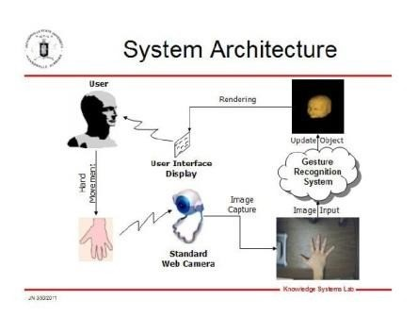
Architecture
Click tohand add txt
Hand gesture detection

Slide 13
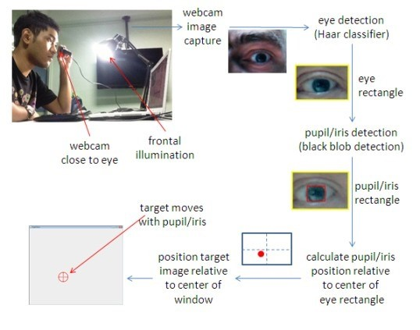
Eye motion tracker

Slide 14
DESIGN
PHASE​
​
Click to ad text

Slide 15
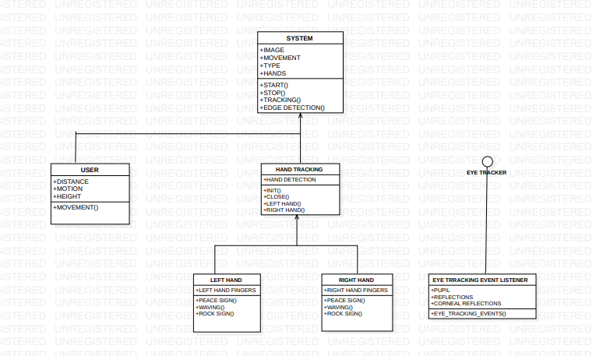
CLASS DIAGRAM

Slide 16
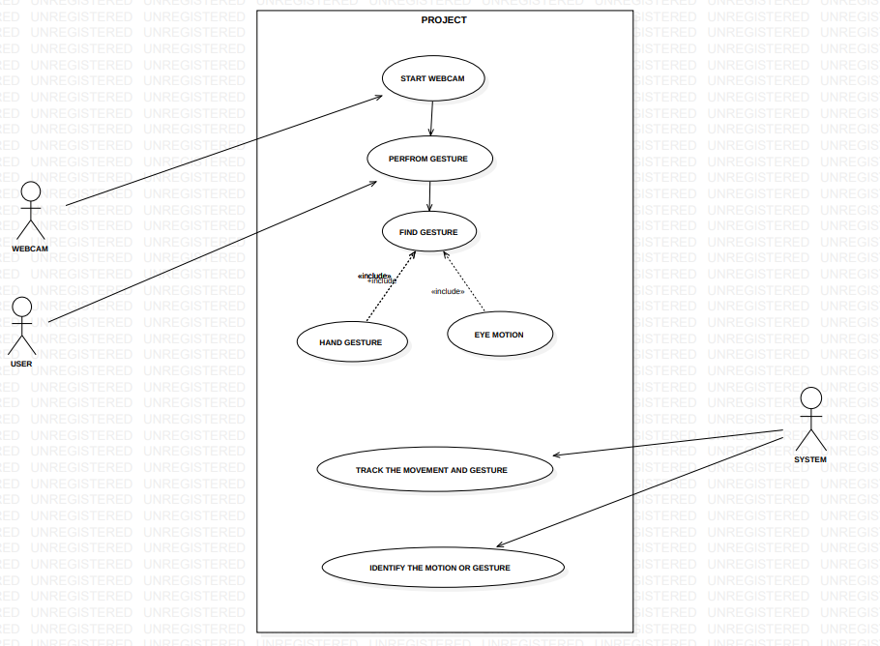
USE CASE DIAGRAM

Slide 17
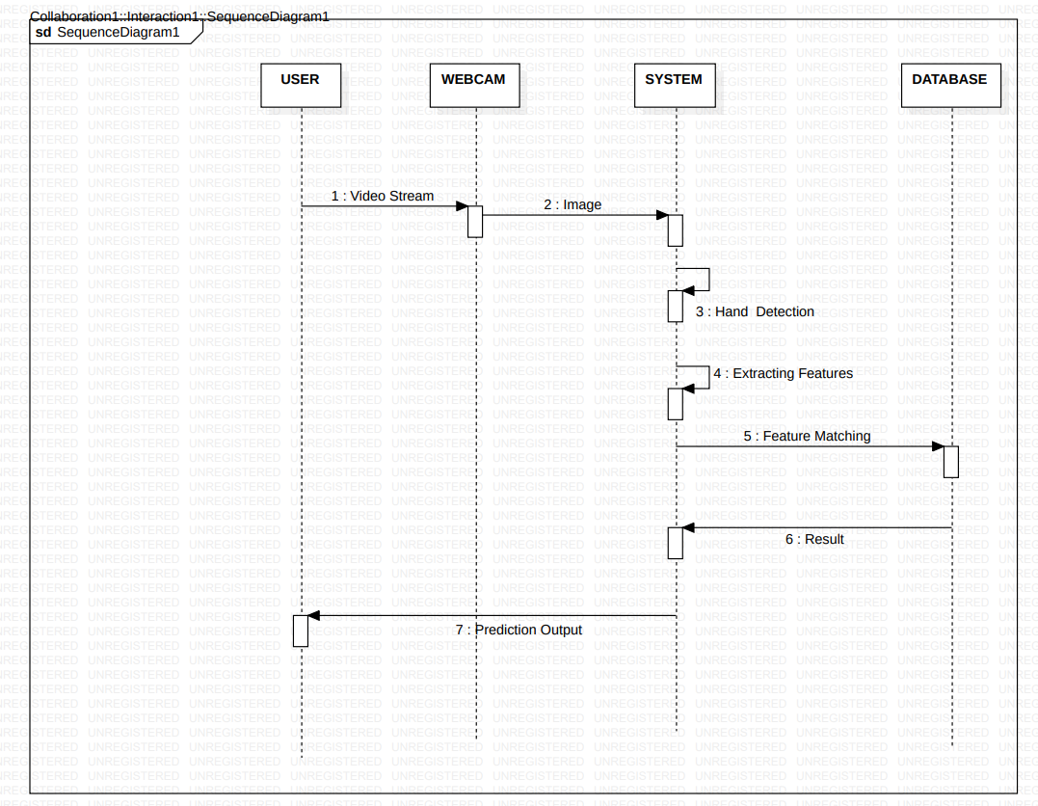
SEQUENTIAL DIAGRAM

Slide 18
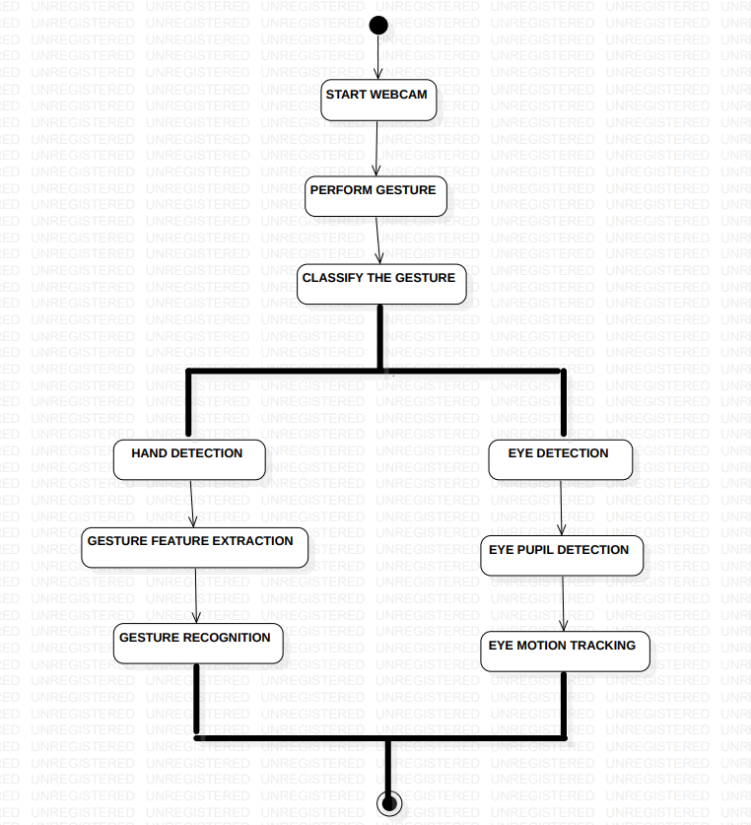
ACTIVITY DIAGRAM

Slide 19

Implementation Methodology
1.Start the Web cam
2.The web cam grabs the frames by using OPENCV which takes all the drawings like hand gestures and eye motions in different ways presented in different backgrounds which uses machine learning approach (deep neural networks) i.e. crops the hands in a given area predicts the hand gestures.
and also subtracts the background from the given image.
Image moments consist of center of mass,
variance, and orientation as follow.
Formula used for image moments is ==

Slide 20
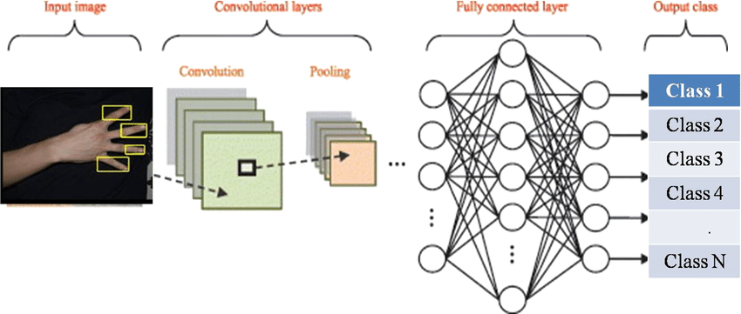
3.These grabbed frames are represented in computer as RGB matrix that contains all the information of the images.
4. These images are passed through CNN(Convolution Neural Networks) which is a AI network widely used for image or object recognition. This deep learning model is used for processing of data that has Grid pattern.
The images passed to CNN are pre-processed and feature
Extracted data.

Slide 21
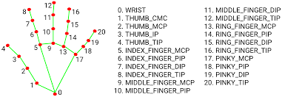
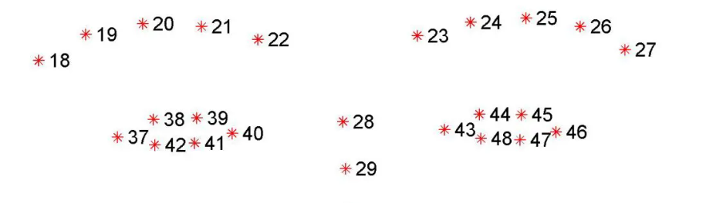
5. The obtained hand and eye landmarks are passed through a feed-forward neural network. ​.
6.For efficient usage we have pre-made ready to use neural networks in Google’s Media-Pipe.
Here Hand and Eye landmarks are pre-classified.
​
7.These neural network extracts the hand and eye landmarks and classify the hand gestures and tracks the eye motion​.

Slide 22
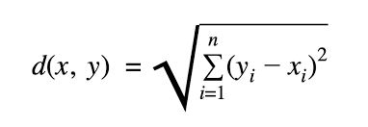
8.To be more precise the distance between the landmarks on the fingers and eye are calculated using the Euclidian Distance formula i.e.
9. Classification of hand gestures and eye motions is recognition of the given gesture (peace, rock and roll etc.) or eye motions(left, right, count the no of blinks).​.
.

Slide 23
Packages
OpenCV (Open-Source Computer Vision Library) is a library of programming functions mainly
• aimed at real-time computer vision. It is a great tool for image processing and performing computer
• vision tasks. It is an open-source library that can be used to perform tasks like face detection
• objection tracking, landmark detection, and much more. It supports multiple languages including python, C++.
Media Pipe is a Framework for building machine learning pipelines for processing time-series data
• like video, audio, etc. This cross-platform Framework works in Desktop/Server, Android, iOS, and
• embedded devices like Raspberry Pi and Jetson Nano.
TensorFlow is an end-to-end open-source platform for machine learning
• Used in a wide variety of programming languages, most notably Python, as well as JavaScript, C++, and Java.
• Easy Modeling Building
• Robust ML production anywhere

Slide 24
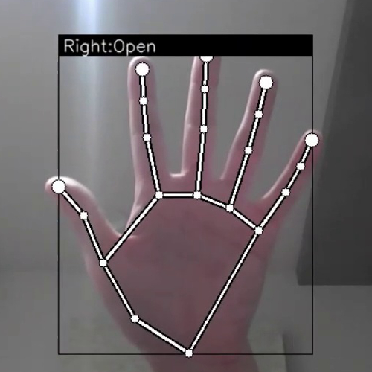
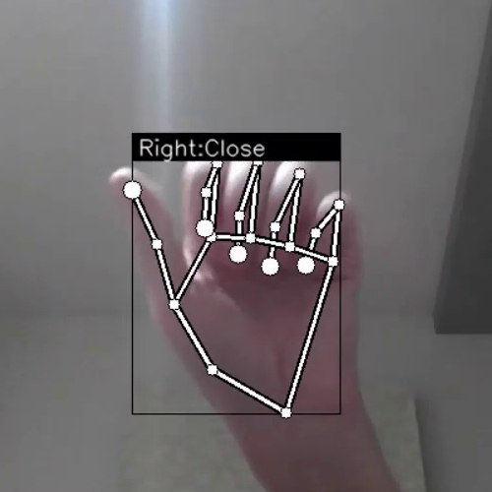
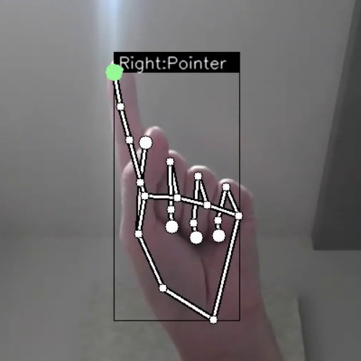
Results

Slide 25
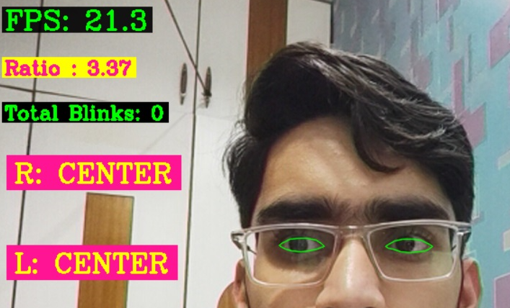
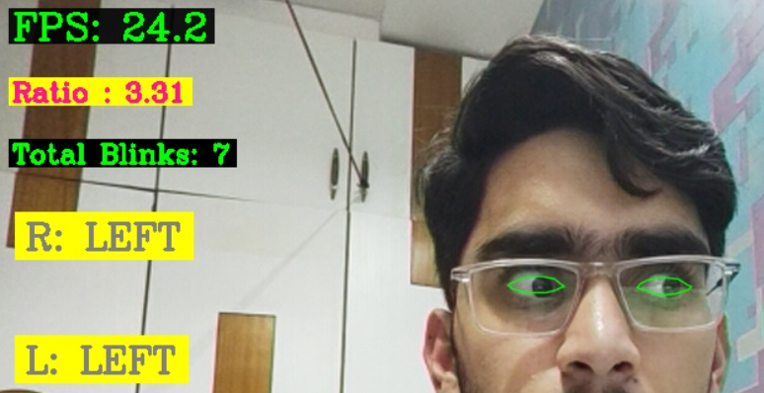
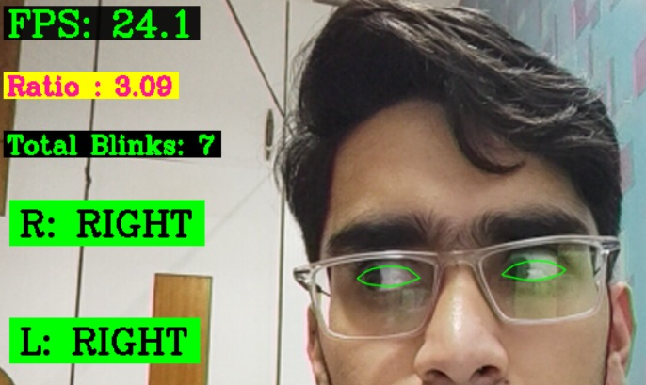
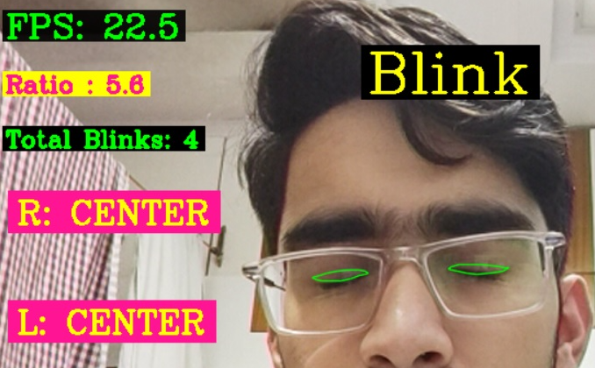

Slide 26
CONCLUSION
The project presented a program that allowed user to perform hand gestures for interpreting the sign language, gestures and understanding the signs. A vision-based hand gesture system that tracks the position of the fingers both left and right hand and based up on the sign shown it projects the name of the sign in its label. Another program eye motion tracker, detects the movement of pupil and labels the direction in which the user is looking. The main motivation was to design a seamless project for disabled people for their better communication.

Slide 27
REFERENCE
https://www.leadingindia.ai/downloads/projects/VP/vp_9.pdf
https://github.com/kinivi/hand-gesture-recognition-mediapipe
https://github.com/dabhisharad13/Hand-gesture-recognition-using-OpenCv-and-Cnn

Slide 28
THANK YOU

